Slide 1
Git and Github by Command
How Alex uses git with small teams of other people
(there are many other ways)
Major Sources:
Matplotlib: http://matplotlib.org/devel/gitwash/development_workflow.html
Linux: http://www.mail-archive.com/dri-devel@lists.sourceforge.net/msg39091.html

Slide 2
Roadmap
Key git concepts
Actually using git on Windows
Actually doing work with git on a small team (one way)

Slide 3
Key Git Concepts
Everyone has a full copy of everything (nothing and nobody is special)
This happens when you initialize your local repository by cloning a remote repository (almost always the remote is hosted on Github)
(When you merge your work, your are merging changes, not files)
Work is done on local feature branches. Feature branches are sets of changes you make when you work on a single scope of work.
When you are finished with a scope of work, you must merge your feature branches back to the remote.
This is where things get tricky, but if we do the feature branches right, it is manageable.
A git “repository” aka “repo” is a folder in your filesystem and all of its subfolders.
A git repo is also a hidden sqlite database which keeps a record of all of your branches, and a “.gitignore” file describing the file types to keep out of your branch histories.
Each clone of a repo has its own history. Mess with your own history all you want, but mess with the remote’s history at your project’s peril.

Slide 4
Actually using git on Windows

Slide 5
Install Git
http://git-scm.com/downloads => Download for Windows and follow instructions.
Choose defaults for end-of-file behaviors when prompted during install.
Get the URLs and permissions for each repository you want to work with
(e.g. https://github.com/CUAHSI/wdc-hiscentral.git)

Slide 6
Make a shortcut to each Git repo on your desktop
Shortcut target (default for Win32 systems): C:\Windows\SysWOW64\cmd.exe /c ""C:\Program Files (x86)\Git\bin\sh.exe" --login -i“
Right-click shortcut, set “Start in” to the folder you want the git repo to be cloned to
Cloning will create a directory in this folder with all of the items in the git repository

Slide 7
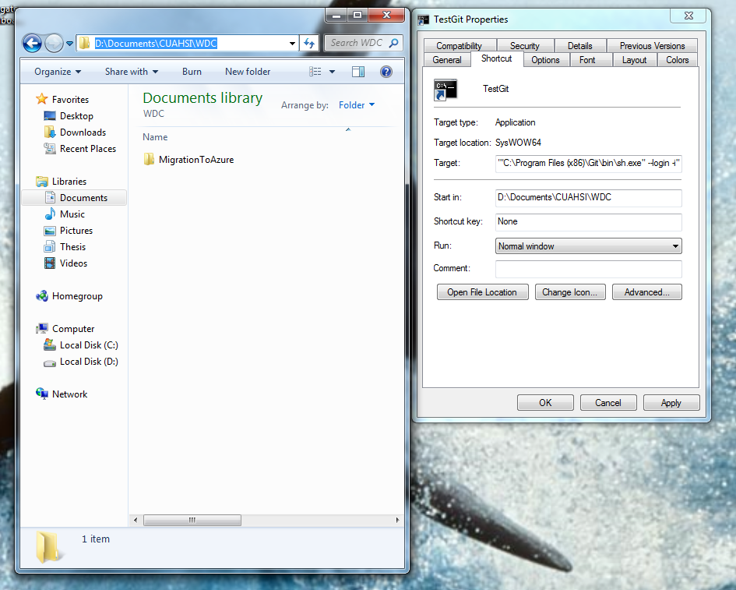
Repo will be cloned into this directory

Slide 8
Start the git command line from the shortcut and clone the repo
Type: git clone https://github.com/CUAHSI/wdc-hiscentral.git
Enter your github username and password when prompted
Pro tip: pressing the up arrow from the command line will cycle through your recent commands.

Slide 9
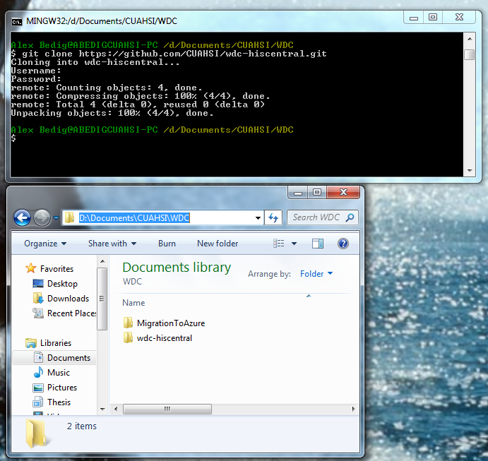

Slide 10
Now, change your shortcut to work with the cloned directory
Close the git terminal
Right-click on shortcut => Properties => Enter the path of the just-created cloned directory into the Start in: line.
You’re now ready to do work!

Slide 11
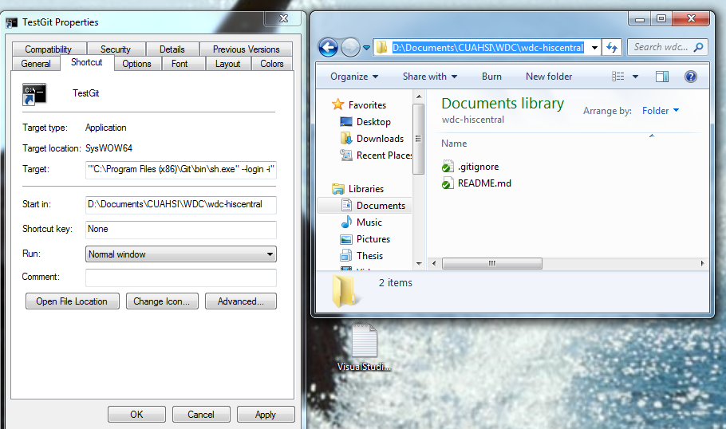
Set the Start in: property to the top-level folder of the cloned git repository

Slide 12
Actually doing work with git

Slide 13
Doing work
Update your local repository with the latest version of the remote:
git pull origin master
Create a feature branch to contain the changes you are going to make
git checkout -b nameOfFeatureBranch
Make some changes
View changed files at any time: git status
Add your changes to your local branch
git add .
Commit your changes to your local branch
git commit –m “thoughtful but not overly verbose description of my changes”

Slide 14
Merging your work
Switch to your local master
git checkout master
Pull latest changes from remote master
git pull origin master
Switch to your feature branch
git checkout myFeatureBranch
Merge local master with your feature branch (if there are conflicts, you will have to resolve them here in your feature branch)
git merge master
Switch to your local master
git checkout master
Merge your feature branch with your local master (all conflicts should have already been resolved, see 4, which keeps your master branch history clean and more easily merged with the remote)
git merge myFeatureBranch
Push your local master to the remote master
git push origin master

Slide 15
Other useful git terms
Figure out what branches you have
git branch
View visualization of merges of history
gitk

